Slide 1

Communication Counters, Timers and PWM
ECE433/ECC533

Slide 2
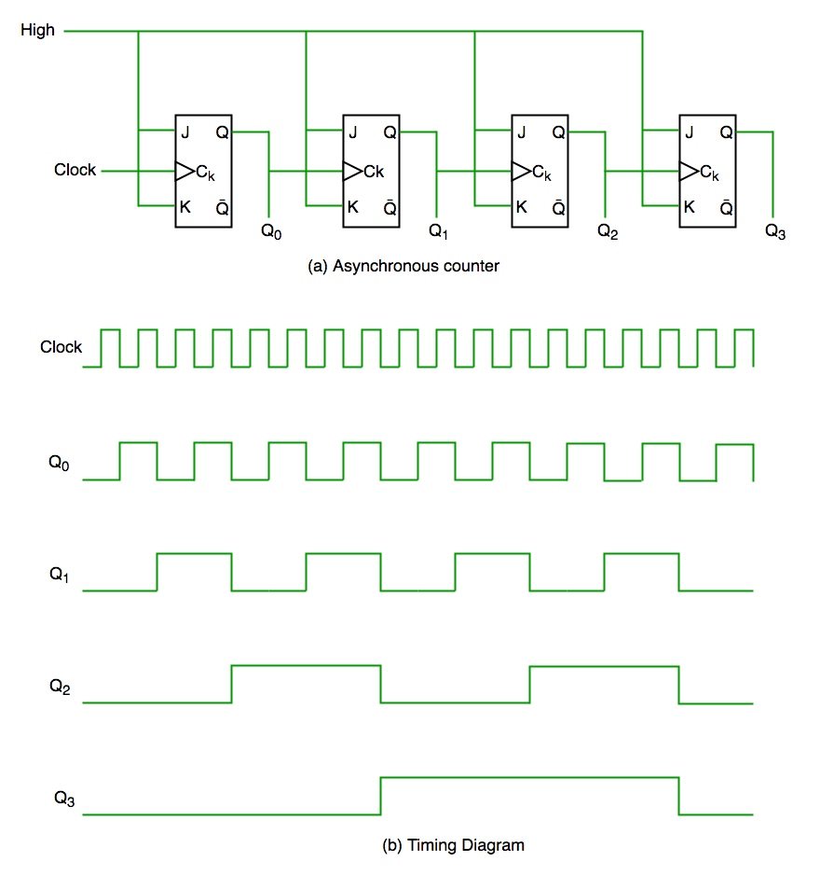
What can you do with a counter?
Clk
Counter
Timer if source clock freq is know
Counter for events on input signal
Start counting after an event
Count edges of external signal
Generate output waveforms
Frequency generator
PWM
Capture time on an event
Generate a single pulse with programmable delay/width

Slide 3
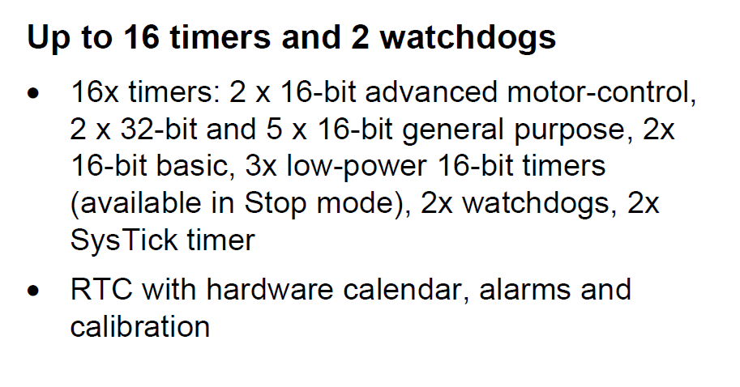
STM32L552 Timers
Types:
SysTick (inside the CPU (Cortex-M33))
General Purpose Timers
Advanced (TIM1, TIM8)
Standard (TIM2/3/4/5/15/16/17) and Basic (TIM6/7)
Low-power Timer (LPTIMx)
From the datasheet

Slide 4
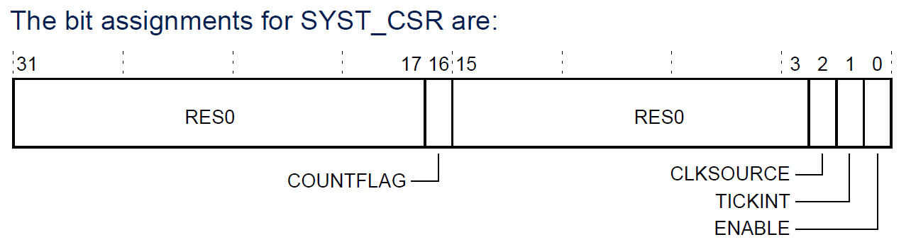
SysTick
LOAD
CLKSOURCE
External Clk
VAL (--)
==0
COUNTFLAG
System Clk
EN
24-bit Count Down Timer embedded in the Cortex M33
Clock sources either CPU clock (1: HCLK) or 0: HCLK/8
When current counter value (VAL) transition to 0, VAL will be reloaded with LOAD. COUNTFLAG is asserted.
COUNTFLAG is cleared when it is read.
Registers are:
SysTick->LOAD
SysTick->CTRL
SysTick->VAL
SysTick is defined in cortex_m33.h
#include "cortex_m33.h"
Reload
CTRL
COUNTFLAG=1
LOAD
VAL
Time

Slide 5
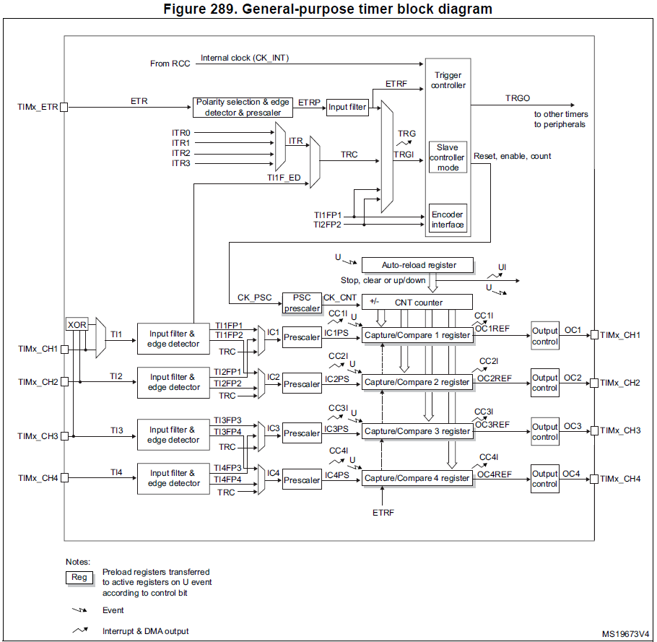
Standard General-Purpose Timers
TIM2/5 are 32-bit
TIM3/4 are 16-bit
Modes:
Input capture
Output compare
PWM generation (Edge- and Center-aligned modes)
One-pulse mode output

Slide 6
Timer Registers
TIMx->PSC : Clock prescaler, slows down source clock
TIMx->ARR : Auto Reload Reg, upper bound for counter
TIMx->CCMRn: Capture/Compare Mode Reg, operation mode
TIMx->CCER : Capture/Compare Enable Reg
TIMx->CCRn : Capture/Compare Reg, *action* when CNT==CCR
TIM2->CNT : Counter, real-time value of counter
TIM2->CRn : Control Reg, control for Timer IP

Slide 7
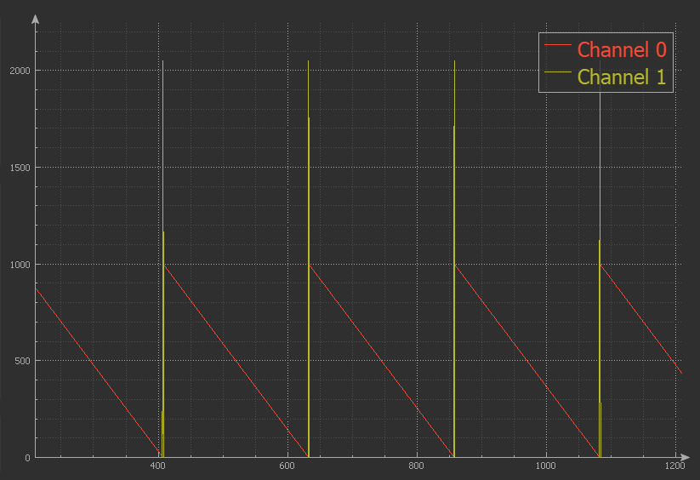
1- As a timer
UIF=1
ARR
CNT
Time
#define COUNT_DW 0x10
RCC->APB1ENR1 |= 1; /* enable TIM2 clock */
TIM2->PSC = 160000 - 1; /* 16Mhz divided by 160000, 10ms per tick */
TIM2->ARR = 1000 - 1; /* divided by val */
TIM2->CNT = 0; /* clear timer counter */
TIM2->CR1 = 1|COUNT_DW; /* enable TIM2, start the counter 1, 2, 3 ... ARR-1 for COUNT UP */

Slide 8

2- As a Counter Starting on ext. input signal
TIMx_ETR: An event (pos/neg edge) will cause timer to start counting.
// Start counting on posedge coming on PA0
RCC->AHB2ENR |= 1; //Enable GPIOA
GPIOA->MODER &= ~(0x3); // Clear the two bits for PA0
GPIOA->MODER |= (0x2); // Set the mode to AF (10--> 0x2)
GPIOA->AFR[0] &= ~(0xF); // Clear the 4 bits for PA0
GPIOA->AFR[0] |= (0xe); // Set the 4 bits to (AF14) to connect to TIM2_ETR
RCC->APB1ENR1 |= 1; /* enable TIM2 clock */
// Configure TIM2 to use external input as counter clock source
TIM2->SMCR = 0x0077; // Set Slave Mode Control Register with the following configuration:
// - External Clock Mode 1- Rising edges of the selected trigger (TRGI) clock the counter
// - External Trigger input (ETRF)
// - External trigger prescaler OFF
// - External clock mode 2 enabled.
TIM2->CNT = 0; /* clear counter */
TIM2->CR1 = 1; /* enable TIM2 to counts up */

Slide 9
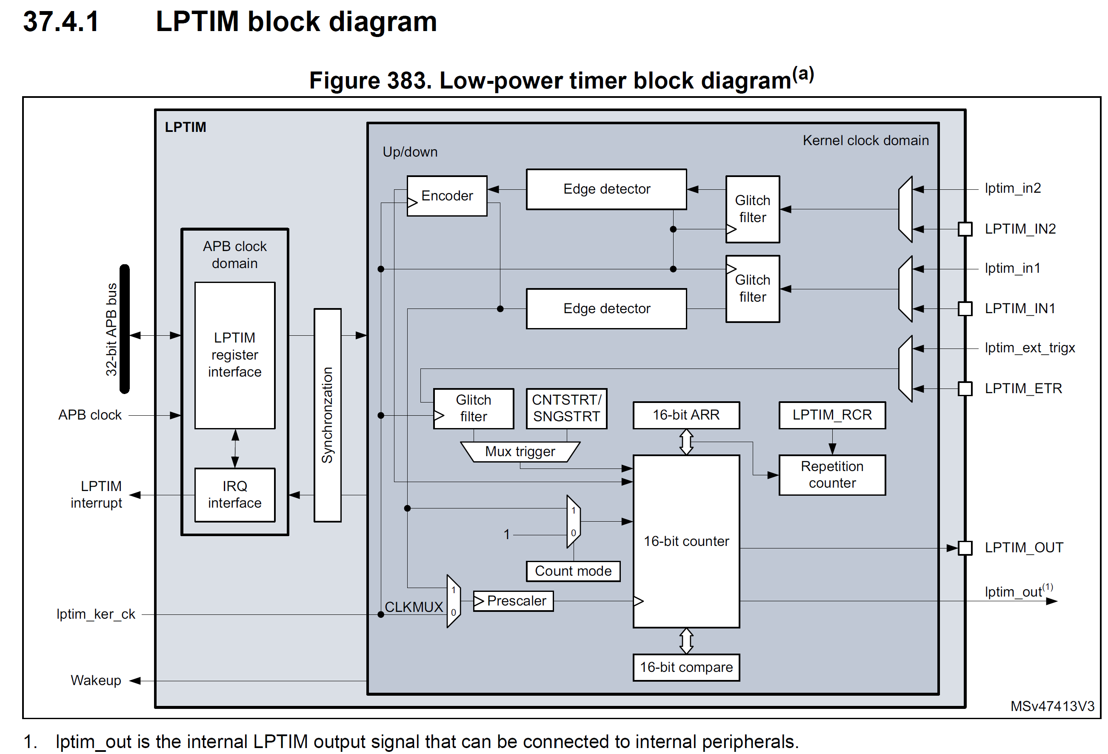


2- As a Counter of ext. input signal
TIMx_IN: An event (pos/neg edge) will cause timer to increment by 1
// Configure LPTIM1 to use external input as counter clock source
// LPTIM_IN1b at PB5
RCC->APB1ENR1 |= 1 << 31; /* enable LPTIM1 clock */
LPTIM1->CFGR = 1|(1 << 23);/* use external clock source, increment counter using external input */
LPTIM1->CNT = 0; /* reset count to 0 */
LPTIM1->CR = 1; /* Enable timer */
LPTIM1->CR |= 0b101; /* Timer in continuous mode – LPTIM must be enabled */
LPTIM1->ARR = 100-1; /* count up 100 times */

Slide 10
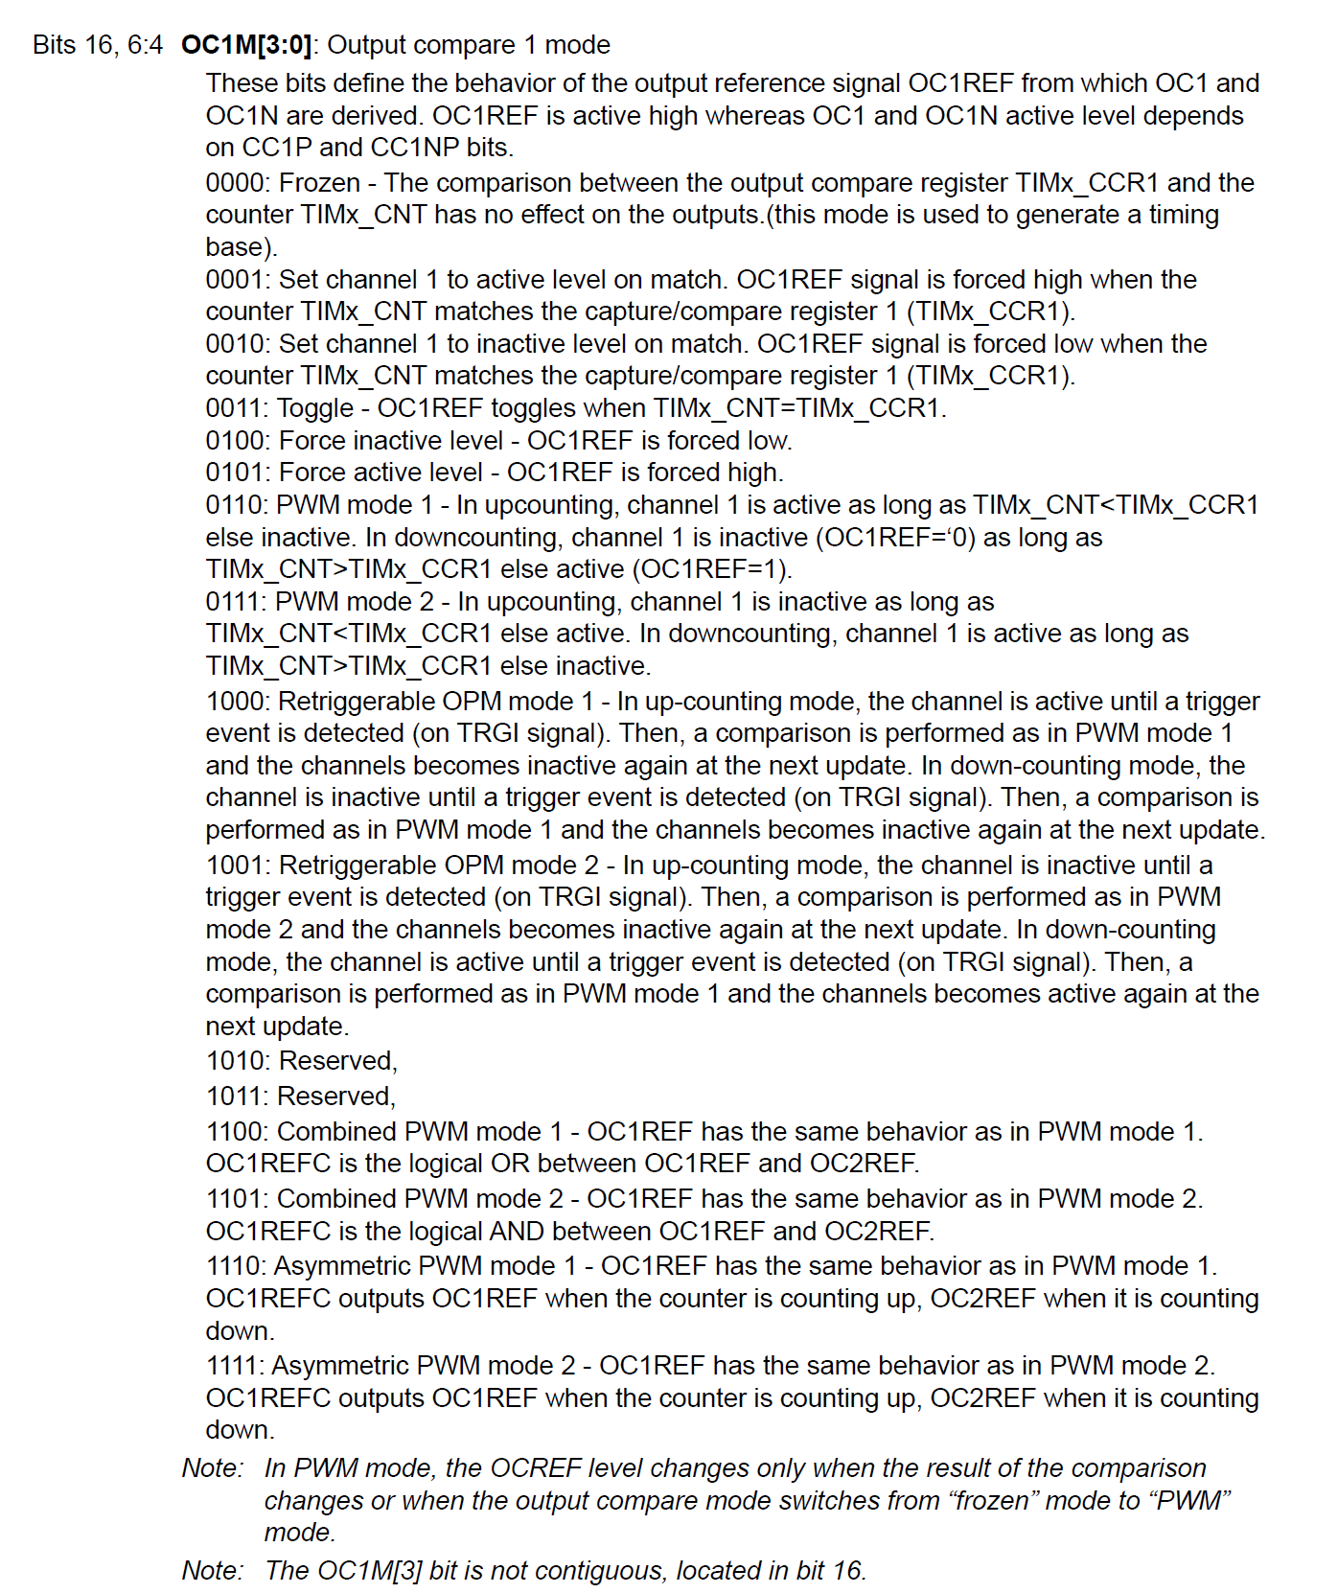
TIMx->CCMR
OCxM[3:0] configures the compare mode
Set/clear/toggle on CCR match
PWM

Slide 11
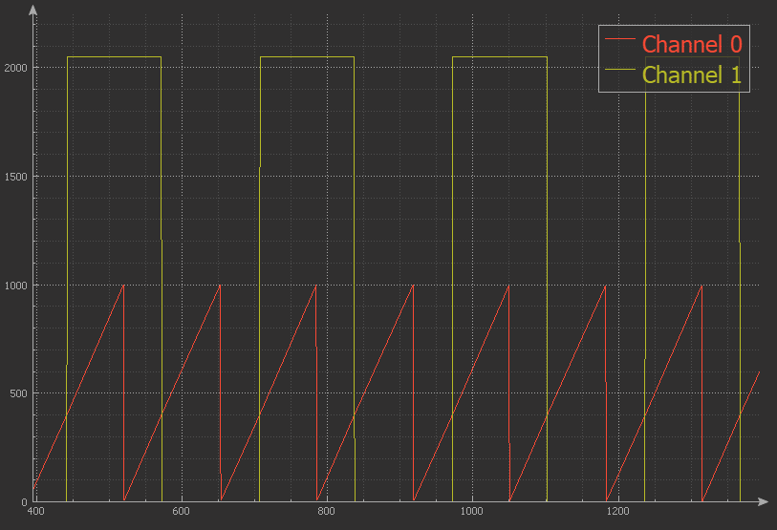
3- As Frequency Generator
UIF=1
ARR
CCR1
CNT
// Using Toggle on match mode
RCC->APB1ENR1 |= 1; /* enable TIM2 clock */
TIM2->PSC = 16000 - 1; /* divided by 16000, for 1ms tick */
TIM2->ARR = 1000 - 1; /* divided by 1000 */
TIM2->CCMR1 = 0x30; /* set output to toggle on match */
TIM2->CCR1 = 400; /* set match value */
TIM2->CCER |= 1; /* enable CH1 compare mode */
TIM2->CNT = 0; /* clear counter */
TIM2->CR1 = 1; /* enable TIM2 */
Time
Freq is controlled by ARR and PSC
Phase is controlled by CCR1

Slide 12
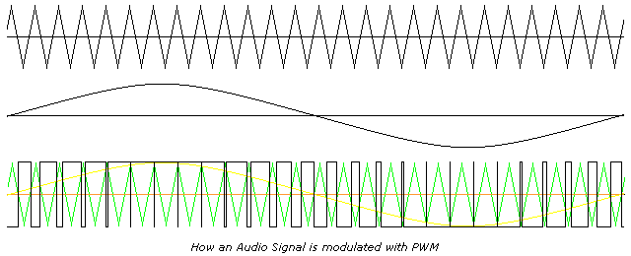
Pulse Width Modulation
Pulse-width modulation (PWM), or pulse-duration modulation (PDM), is a method of reducing the average power delivered by an electrical signal, by effectively chopping it up into discrete parts. The average value of voltage (and current) fed to the load is controlled by turning the switch between supply and load on and off at a fast rate. (Wiki)

Slide 13
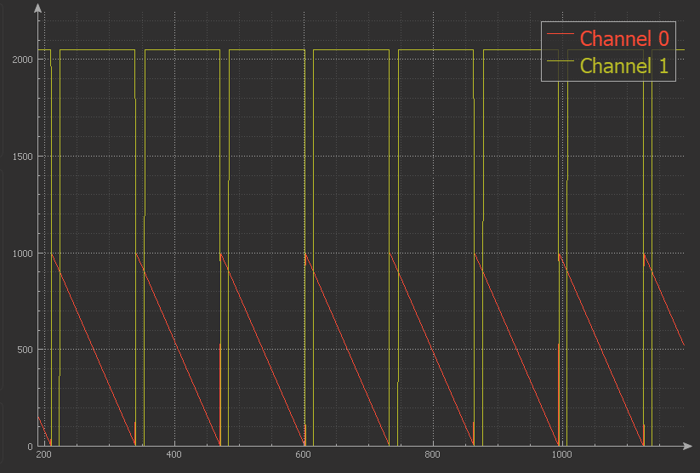
4- PWM - Edge aligned
UIF=1
ARR
CCR1
CNT
// Use Case 2: PWM mode 1
RCC->APB1ENR1 |= 1; // enable TIM2 clock
TIM2->PSC = 16000 - 1; // divided by 16000
TIM2->ARR = 1000 - 1; // divided by 1000
TIM2->CCMR1 = 0x60; // PWM, High if CNT<CCR1 if count down
// or if CNT>CCR1 if count up
TIM2->CCR1 = 900; // set match value
TIM2->CCER |= 1; // enable CH1 compare mode
TIM2->CNT = 0; // clear counter
TIM2->CR1 = 0x11; // enable TIM2 , count down
Time

Slide 14
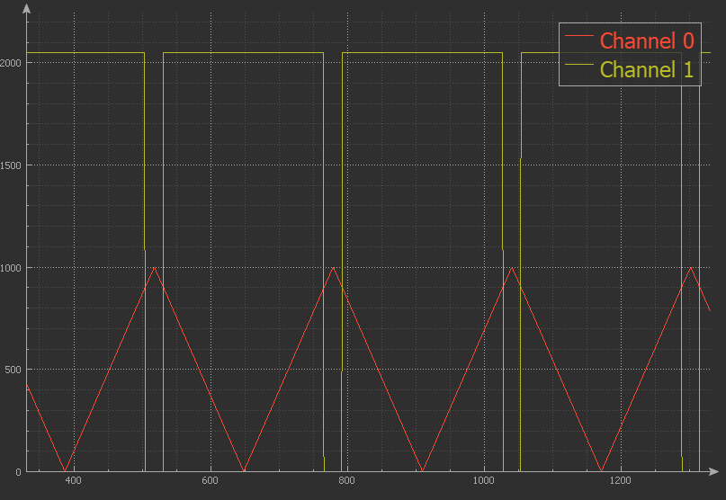
5- PWM - Center aligned
UIF=1
ARR
CCR1
CNT
// Use Case 3: PWM mode 1 - Center Aligned
RCC->APB1ENR1 |= 1; // enable TIM2 clock
TIM2->PSC = 16000 - 1; // divided by 16000
TIM2->ARR = 1000 - 1; // divided by 1000
TIM2->CCMR1 = 0x60; // PWM, High if CNT<CCR1 if count down
// or if CNT>CCR1 if count up
TIM2->CCR1 = 900; // set match value
TIM2->CCER |= 1; // enable CH1 compare mode
TIM2->CNT = 0; // clear counter
TIM2->CR1 = 0x61; // enable TIM2 , Center-aligned
Time

Slide 15
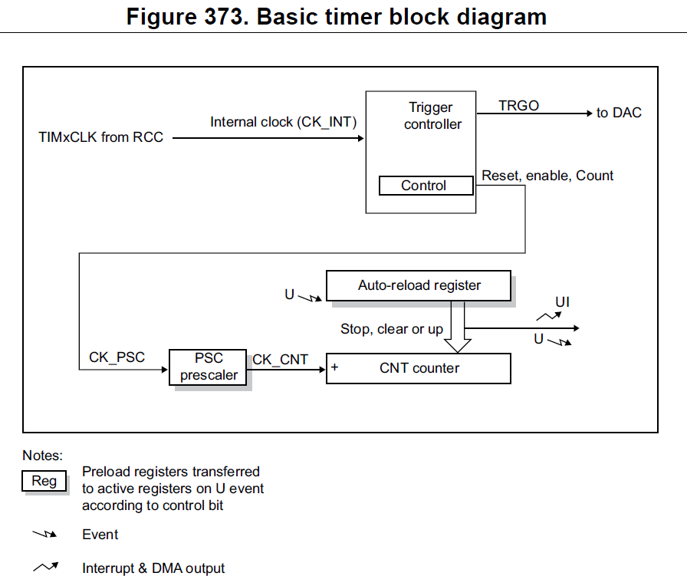
Basic Timers
TIM6/TIM7
16-bit count up
Overflow flag
Triggers the DAC

Slide 16
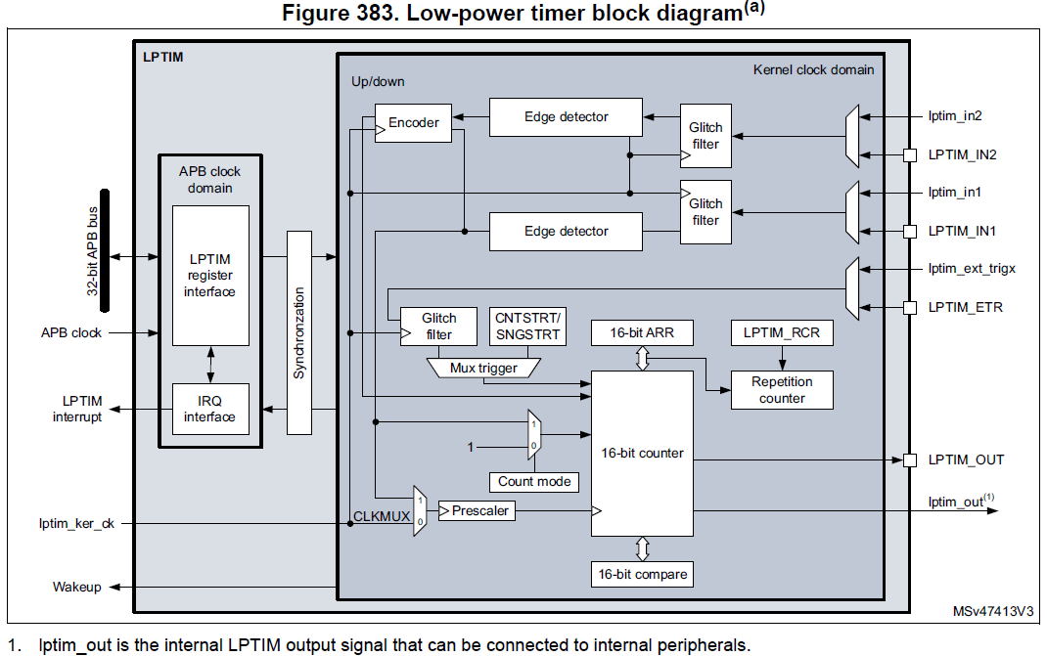
Low-Power Timers
LPTIM1/2/3
16-bit count up
Can work in STOP mode with out LP clock running.

Slide 17
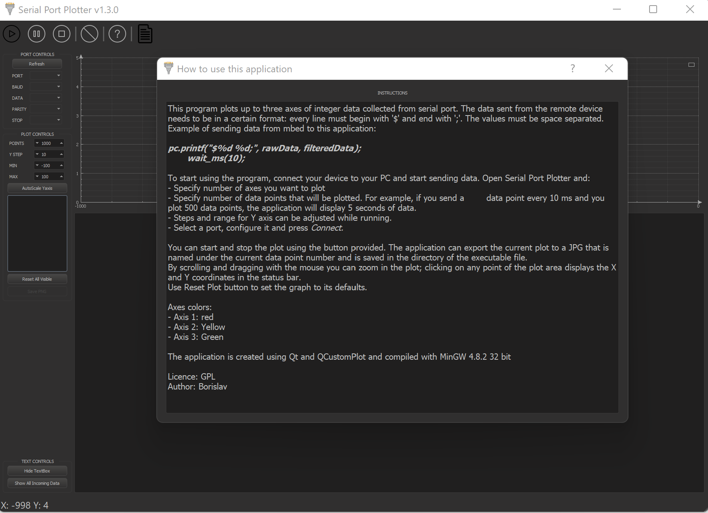
Serial Port Plotter
Download the tool:
https://github.com/CieNTi/serial_port_plotter/releases
Comprehensive Training:
https://st-onlinetraining.s3.amazonaws.com/STM32L5-WDG_TIMERS-General_Purpose_Timer_GPTIM/index.html

Slide 18
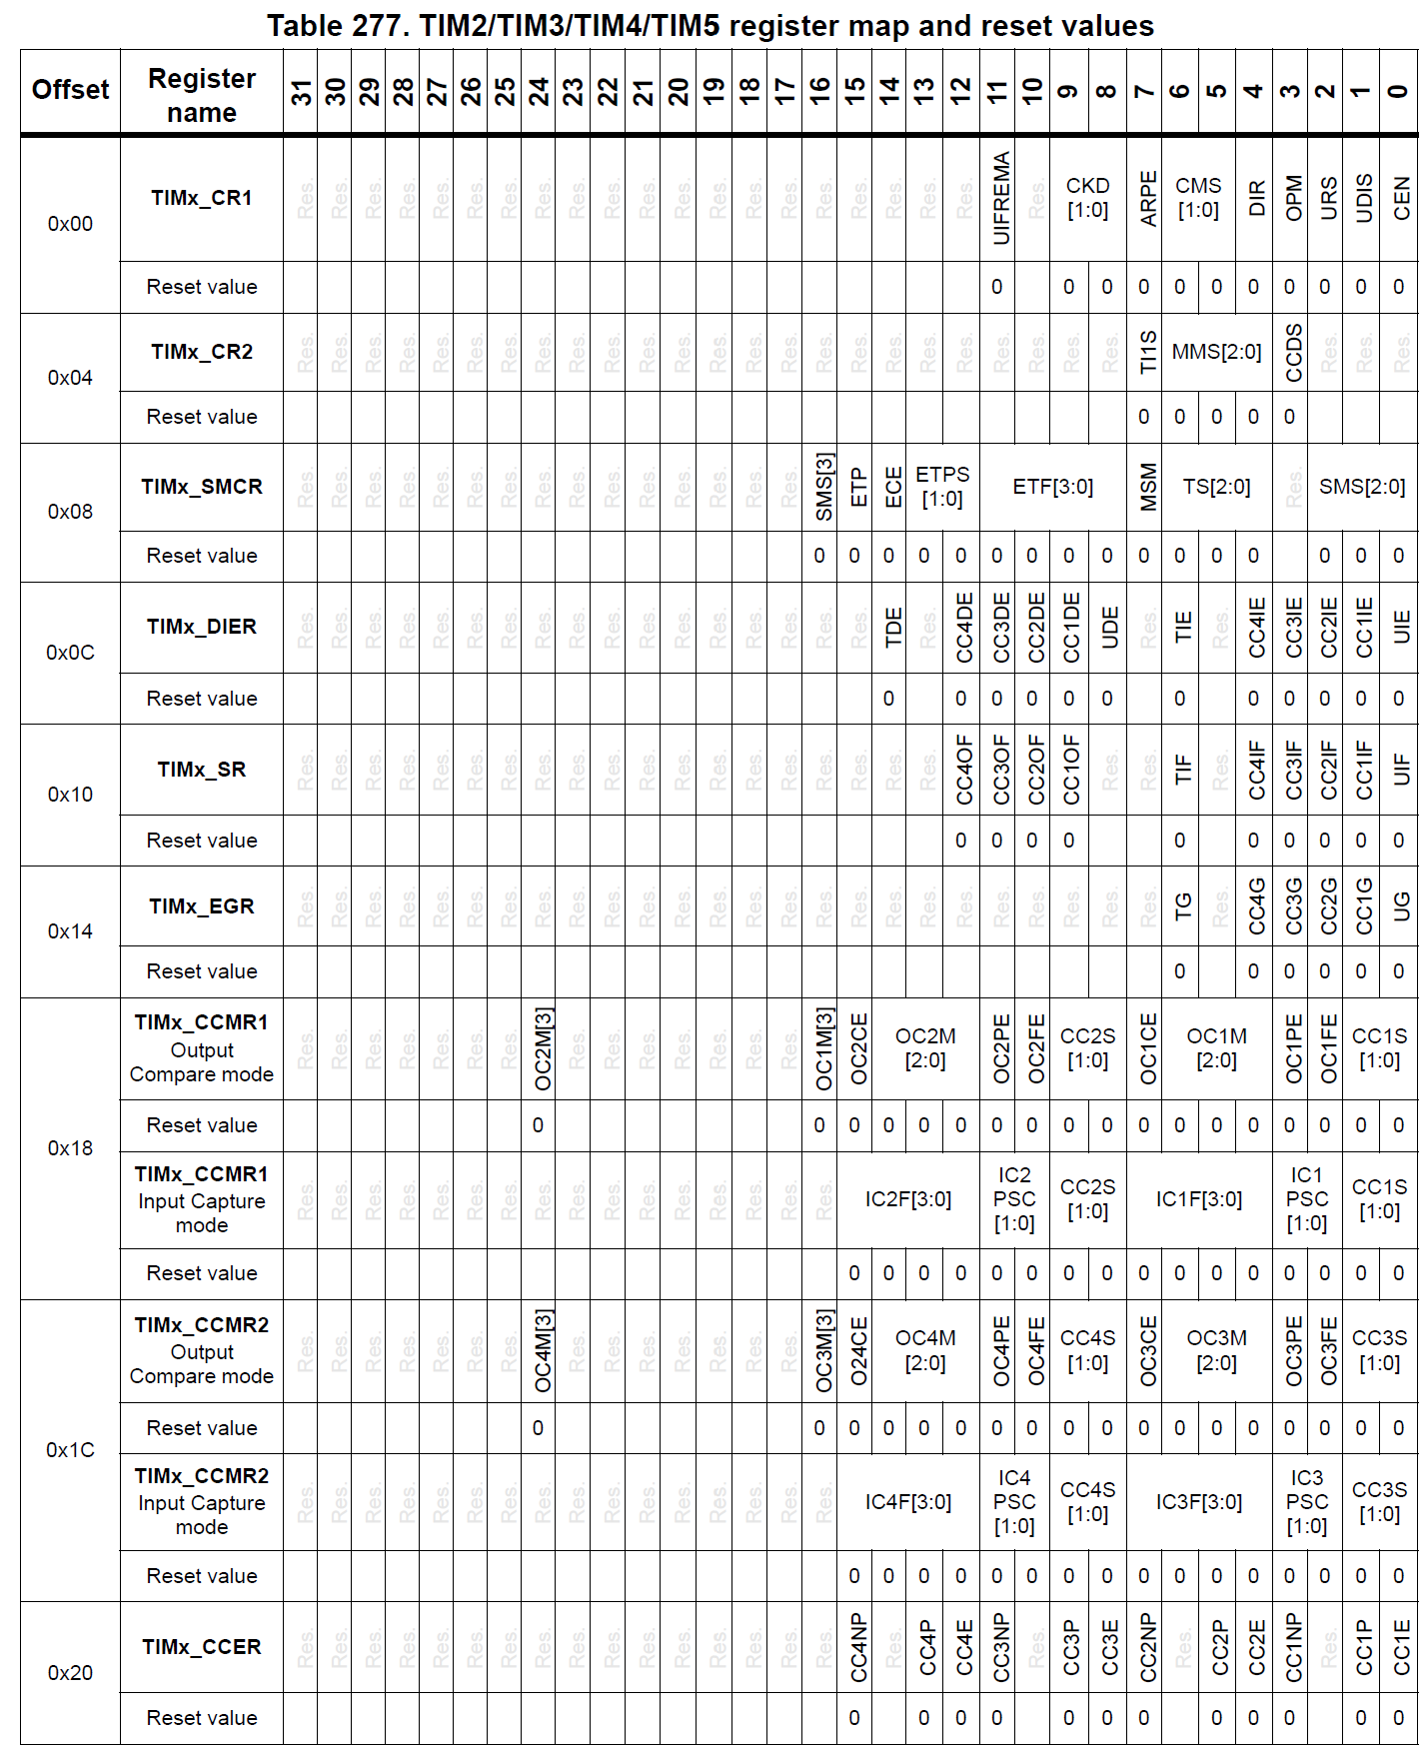
Reg Map:

Slide 19
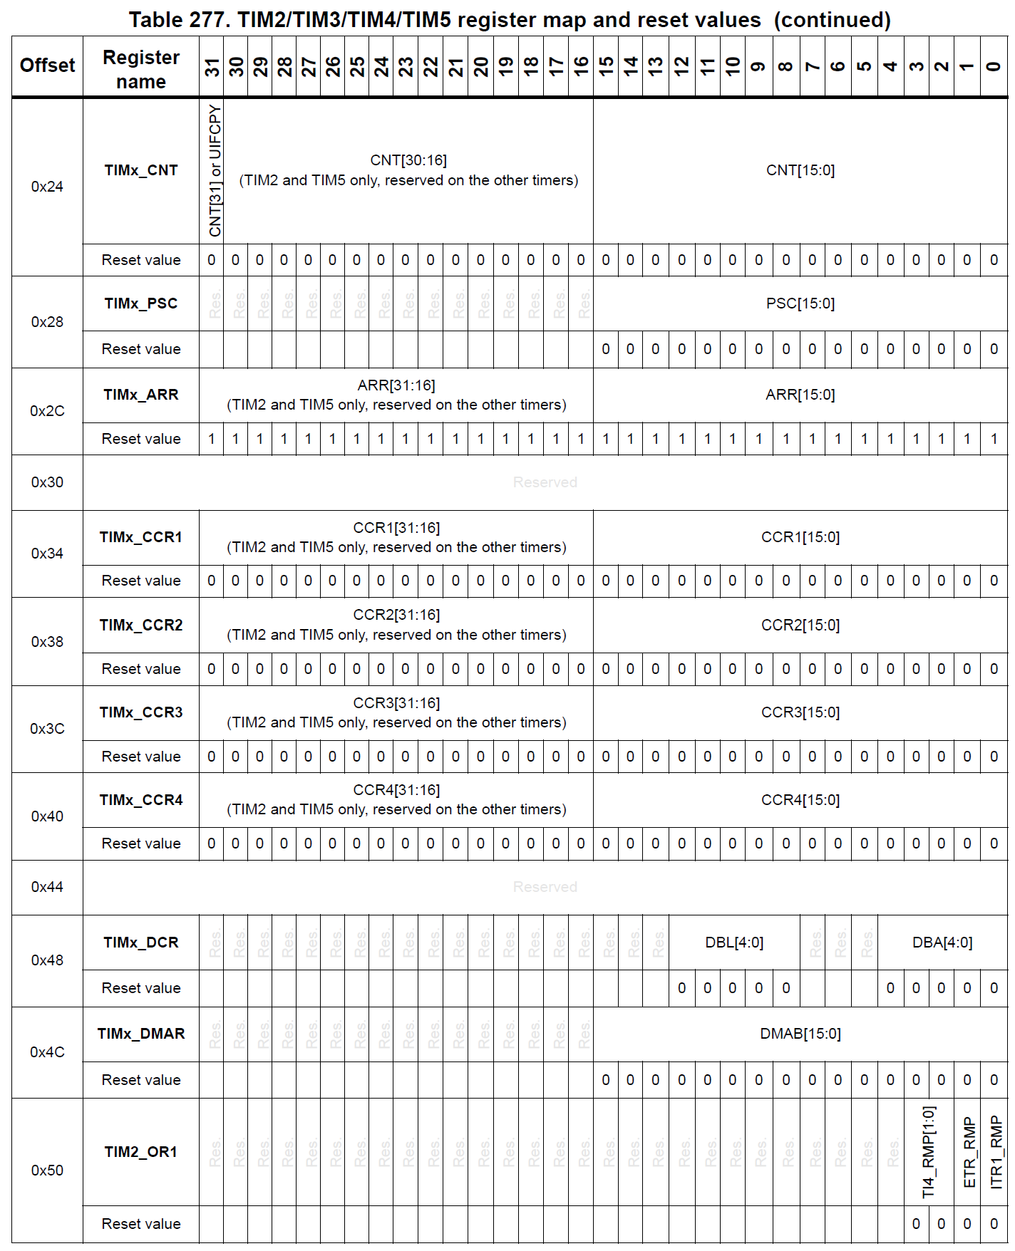
Reg Map:

